Slide 1
CHRONIC RHINOSINUSITIS
Dr.Haval Ahmed Hama
MBChB, F.K.B.M.S
(Otolaryngology, Head and Neck Surgeon)
University of Sulaimani, College of Medicine.
Branch of clinical science.

Slide 2
Learning outcome
Define Chronic Rhinosinusitis (CRS) and identify its diagnostic criteria.
Differentiate between CRSsNP (without polyps) and CRSwNP (with polyps) subtypes.
Recognize the causative factors and pathophysiology of CRS.
Discuss the medical and surgical management options for CRS, including FESS.
Understand the complications and principles of endoscopic sinus surgery.

Slide 3
Chronic Rhinosinusitis
inflammation of the nose and paranasal sinuses for > or 12 weeks associated with two or more symptoms.
one of which should be nasal blockage/obstruction/congestion or nasal discharge:
+/− facial pain/pressure , reduction or loss of smell
and either
endoscopic evidence of polyps and/or mucopurulent discharge from the middle meatus or edema, mucosal obstruction primarily in the middle meatus
and/or
CT changes: mucosal changes within the osteomeatal complex and/or sinuses

Slide 4
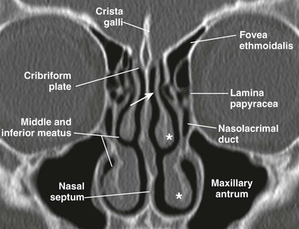

Slide 5
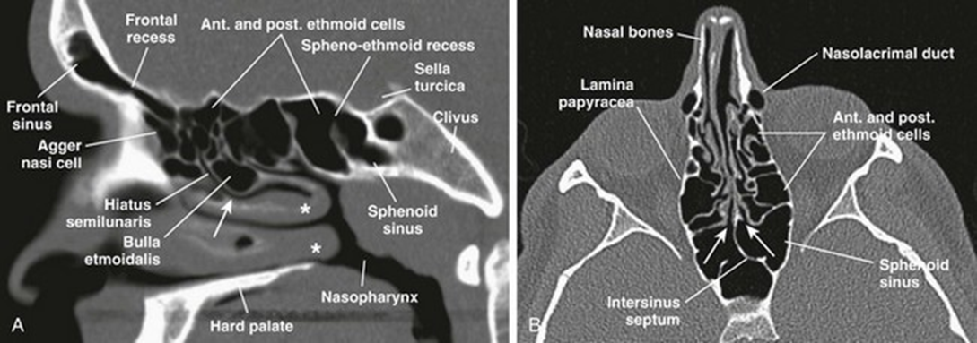

Slide 6
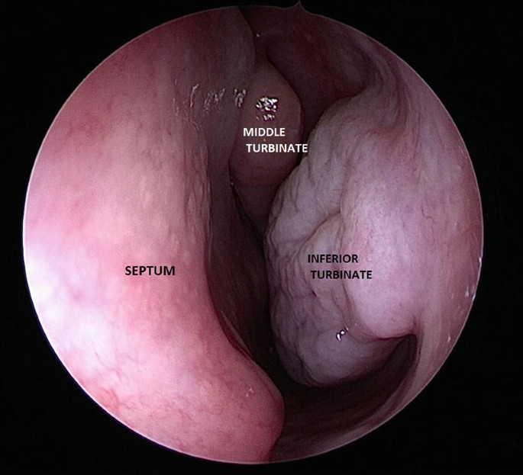

Slide 7
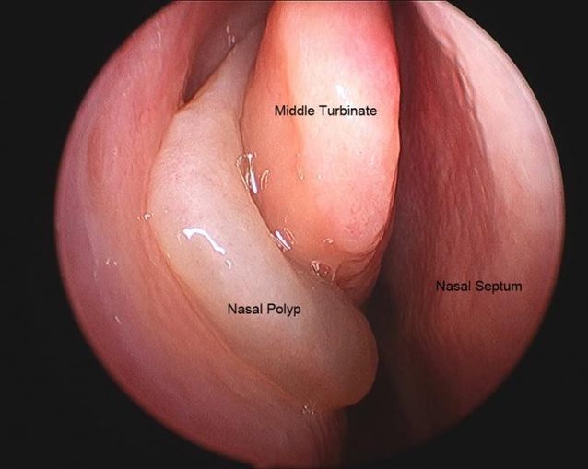
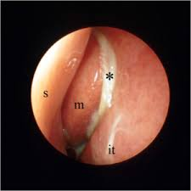

Slide 8
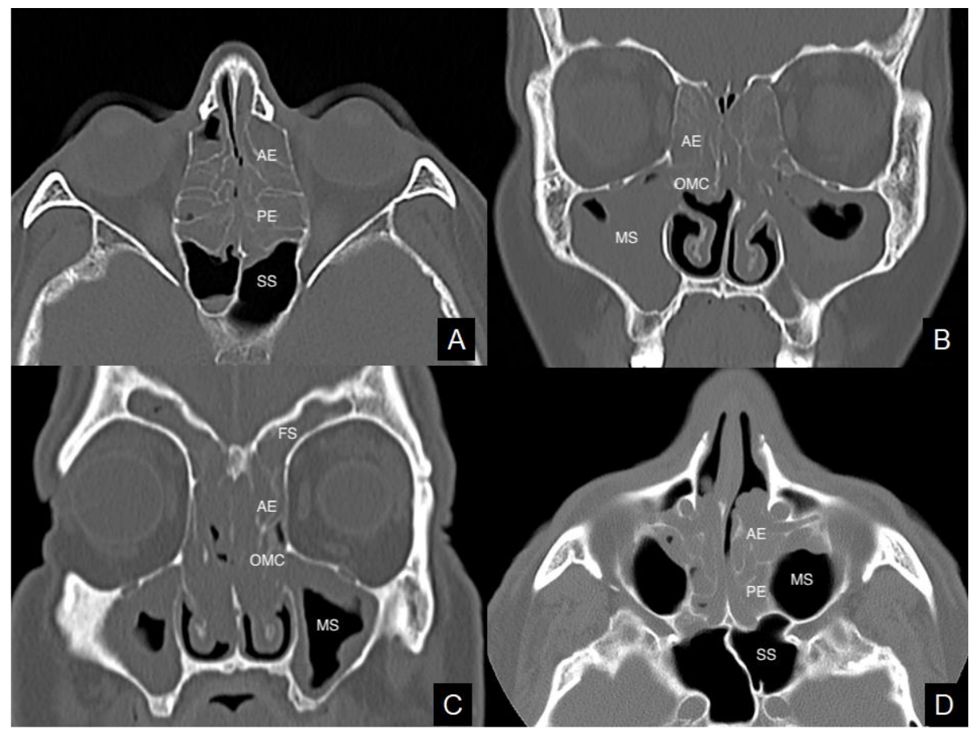

Slide 9
CHRONIC RHINOSINUSITIS
It usually follows acute sinusitis that has not been adequately treated, or it may also follow a cold or tooth infection.
It occurs when the self-cleansing mechanism of the nose and paranasal sinuses gets impaired.
The maxillary sinus is most commonly involved.
Organisms isolated in CRS include Staphylococcus aureus, Pseudomonas aeruginosa, Klebsiella pneumoniae, and Escherichia coli. Anaerobic organisms are also found.

Slide 10
Classification(Sub-types of CRS)
CRSsNP-without polyp
-Facial pain, pressure, and/or fullness
Organism : S.pneumoniae, H.influenzae, M.catarrhalis, S.aureus, S.coagulase-negative
-Glandular hyperplasia and submucosal fibrosis
CRSwNP-with polyp
- Hyposmia/anosmia
-Nasal polyps are typically bilateral
associated with AERD
-The predominance of eosinophils, high levels of histamine, and Th2 cytokines

Slide 11
AFRS(allergic fungal rhinosinusitis)
-Presence of allergic mucin (thick mucus, light tan to brown to dark green, degranulated eosinophil)
-fungal hyphae in mucin
-evidence of IgE-mediated fungal allergy
Sinus surgery is usually required
Usually have nasal polyps and immunocompetent patient
Pathophysiology: chronic, allergic inflammation directed against colonizing fungi

Slide 12
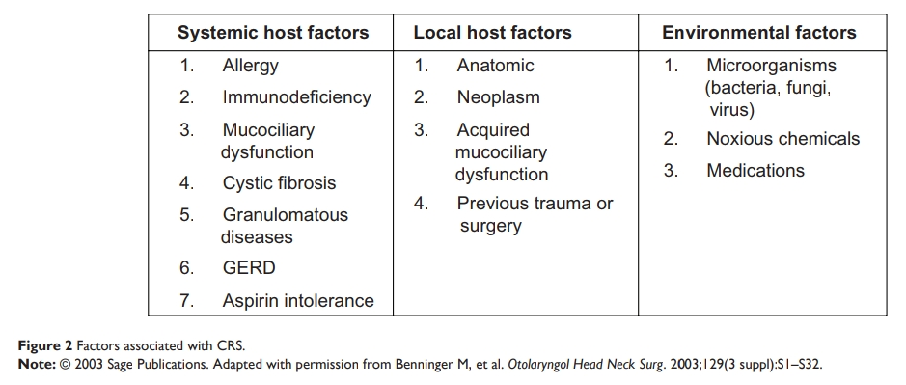
FACTORS ASSOCIATED WITH CHRONIC RHINOSINUSITIS

Slide 13
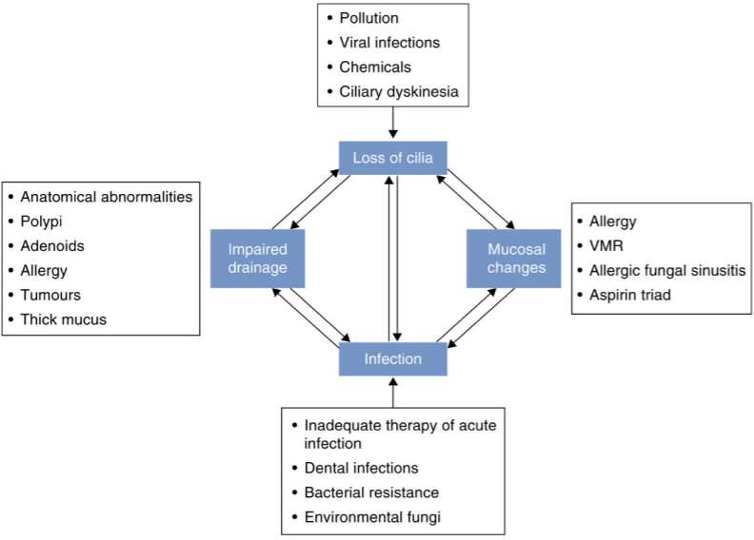
Causative Factors And Pathophysiology Of Chronic Sinusitis.

Slide 14
Management
A-Medical treatment:-
1-corticosteroid:
-topical nasal steroid sprays like fluticasone, and mometasone, are recommended for all forms of CRS
-systemic steroid: prednisolone tablet 0.5-1mg/kg in tapering dose
for refractory cases or unfit for surgery
before surgery to reduce polyp size
2-Antihistamines: helpful in allergic rhinitis
3-Antibiotics: used to treat the infection if nasal purulence is present ( acute exacerbation ) or to modulate immunity like macrolides and doxycycline
4-Antifungals: Indicate only in invasive forms of sinus mycosis

Slide 15
5-Nasal saline irrigation:
it improves symptom scores and control
6-Mucus modifiers
theoretically improving mucociliary transport
Guaifenesin 1200 mg twice daily reduced congestion
, postnasal drainage
7-Anticholinergics
blocks parasympathetic input to mucus glands and reduces rhinorrhea
may lead to the increased thickness of secretions and paradoxically worsen postnasal drainage

Slide 16
8-leukotrienes inhibitors:
Leukotriene receptor antagonist (montelukast) can improve symptom scores in CRS patients.
5-Lipoxygenase inhibitor (zileuton) significant improvement in olfaction in patients with CRS and concomitant aspirin-sensitive asthma
9-Decongestants ( little role in CRS )
Topical
Systemic
10-Lifestyle modification
Stop smoking, get adequate sleep, exercise regularly, avoid pollution, plenty of fluid

Slide 17
B-Surgery :
-Conventional surgery especially for nasal polyp, septoplasty
-Functional endoscopic sinus surgery(FESS):procedure of choice for refractory CRS.
Indications
-Anatomic blockage—deviated septum, enlarged turbinate, concha bullosa
-Mucocele
-Orbital abscess
-Fungal sinusitis—allergic vs. invasive (mucor)
-Tumor of nasal cavity or sinus
-Chronic, recurrent sinusitis
-Failure to respond to maximal medical therapy
-Obtain cultures

Slide 18
Principal goal of FESS
Restore patency to the ostiomeatal unit
Correction of septal deformities
Removal of severe concha bullosa deformity
Restoration of patency to the frontal sinus
Delivery of the drug into the sinus
Restoring mucocilliary clearance

Slide 19
Complication of FESS
Minor
Major
-Orbital-
orbital emphysema orbital ecchymosis
-Nasolacrimal Duct Injury(epiphora)
- Disturbance in olfaction
-Dental pain/lip pain or numbness
-Orbital hematoma -Optic nerve injury
-CSF leak
-brain laceration
-hemorrhage
-Ethmoid artery injury
-internal carotid artery to cavernous sinus fistula
-sphenopalatine artery injury

Slide 20
Conclusion
Chronic Rhinosinusitis is a persistent inflammatory condition of the nose and paranasal sinuses lasting more than 12 weeks.
It often results from impaired mucociliary clearance and may follow infection or allergic inflammation.
Accurate diagnosis, based on symptoms, endoscopic findings, and imaging, is essential for effective treatment.
Medical therapy remains first-line, but surgery (FESS) is vital for refractory cases.
Successful management requires a multidisciplinary approach to improve quality of life and prevent recurrence.

Slide 21
Source
Logan and Turner
Scott-brownn

